Slide 1
The Mandelbrot set

Slide 2
Complex numbers
1 × 1 = 1
-1 × 1 = -1
1 × -1 = -1
-1 × -1 = 1
x
a
b
x×(a+b) = x×a + x×b
-1×(3-2) = -1×3 + -1×-2 = -3 + -1×-2
-1×(3-2) = -1×1 = -1
-1 = -3 + -1×-2
So 2 = -1×-2 

Slide 3
The complex plane
Complex
X
b
Real
a

Slide 4
Complex
r = 2
Real

Slide 5
The Mandelbrot set
Z Z² + C
C is given by your position on the complex plane
Start with z = 0 and repeatedly apply the transformation
If the sequence of numbers that comes from this increases to infinity c is in the set, otherwise c is outside the set

Slide 9
(Filled in) Julia sets
Z Z² + C
C is a constant, every value of C gives a different Julia set
Start with z given by the position on the complex plane and repeatedly apply the transformation
If the sequence of numbers that comes from this increases to infinity c is in the set, otherwise c is outside the set
c = -0.738281 + 0.218750i

Slide 10
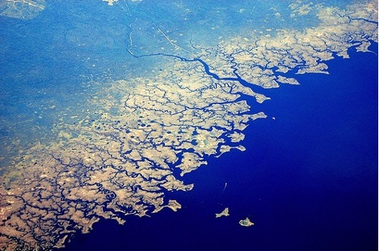

Slide 11
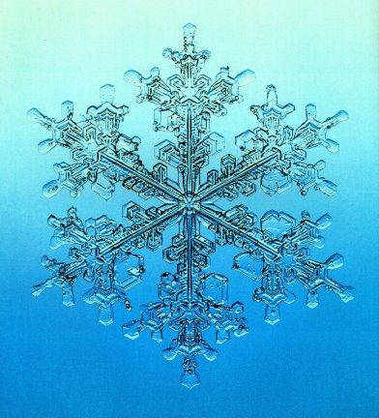

Slide 12
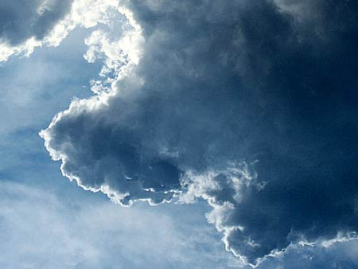

Slide 13
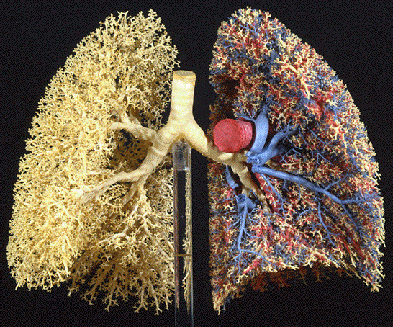

Slide 14
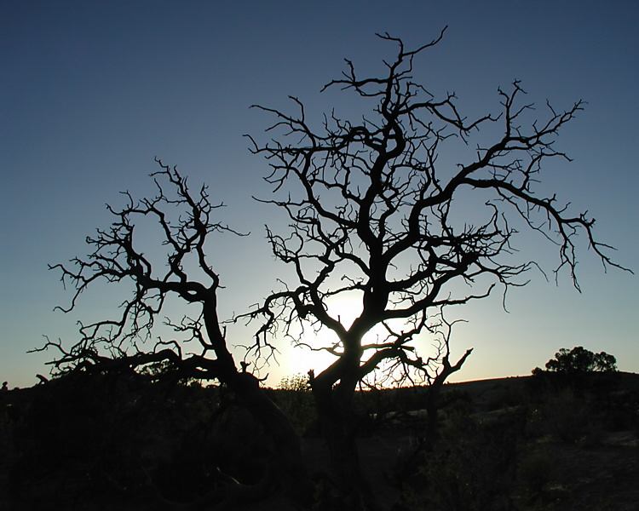
Notes:
http://www.google.co.uk/imgres?q=fractal%3B+tree&hl=en&gbv=2&biw=1280&bih=721&tbm=isch&tbnid=DzQM7_2E_RoCRM:&imgrefurl=http://www.pbase.com/rwalkernm/image/41202777&docid=lvezl3WCRgEX4M&imgurl=http://ic2.pbase.com/u32/rwalkernm/upload/41202777.FractalTree.jpg&w=750&h=600&ei=AGlbT_CAL4G_0QXA0dznCg&zoom=1&iact=hc&vpx=533&vpy=212&dur=945&hovh=201&hovw=251&tx=168&ty=138&sig=114573368585156778329&page=3&tbnh=161&tbnw=213&start=37&ndsp=20&ved=1t:429,r:12,s:37

Slide 15
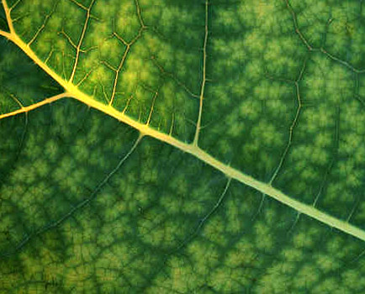

Slide 16
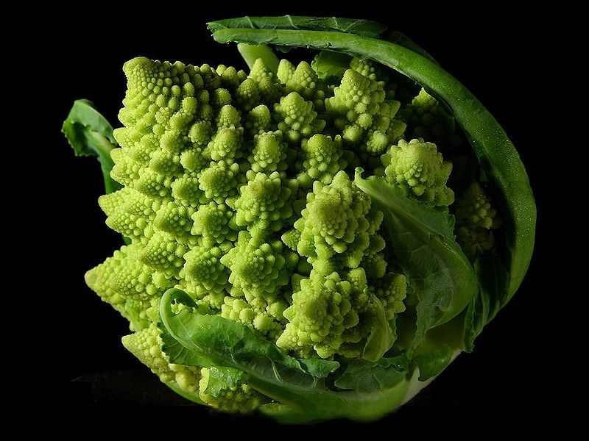
What is a fractal

Slide 17
What is not a fractal
A line twice as wide is twice as big
Dimension 1
Width
1
2
3
4
Size
1 = 1¹
2 = 2¹
3 = 3¹
4 = 4¹

Slide 18
What is not a fractal
A square twice as wide is four times as big
Dimension 2
Width
1
2
3
4
Size
1 = 1²
4 = 2²
9 = 3²
16 = 4²

Slide 19
What is not a fractal
A cube twice as wide is eight times as big
Dimension 3
Width
1
2
3
4
Size
1 = 1³
8 = 2³
27 = 3³
64 = 4³

Slide 20
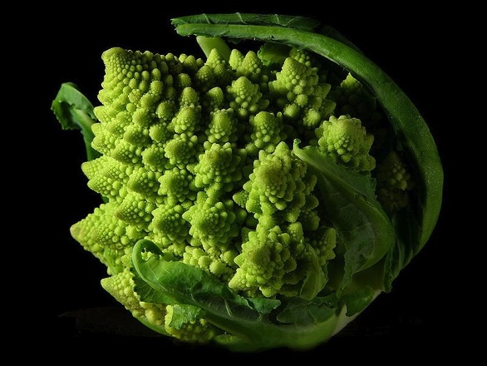
What is a fractal

Slide 21
What is a fractal
Dimension that is not a whole number
Self similar

Slide 22
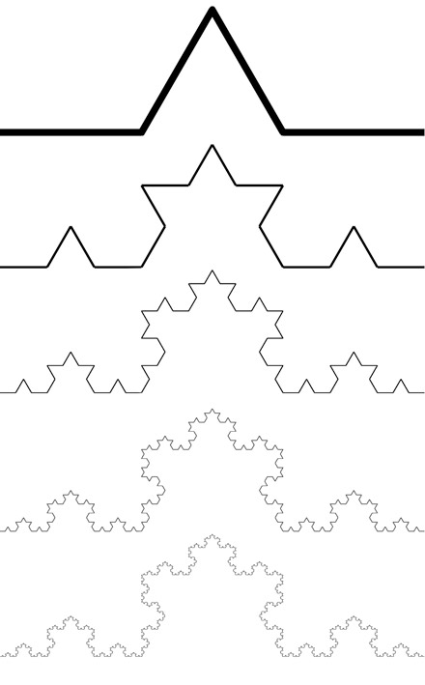
Koch Curve
Notes:
Miquel.com
Simplygreen.co.za
http://www.ibercivis.net/index.php?module=public&section=channels&action=view&id_channel=3&id_subchannel=133
http://therealsasha.files.wordpress.com/2011/10/snowflake-fractal.jpg
http://classes.yale.edu/fractals/panorama/Biology/Physiology/Physiology.html

Slide 23
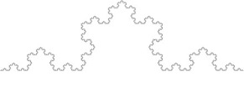
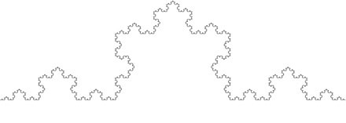
Koch Curve
Dimension
1
2
x
Width
3
3
3
Size
= 3¹
9 = 3²
4 = 3^{x}
Notes:
Miquel.com
Simplygreen.co.za
http://www.ibercivis.net/index.php?module=public&section=channels&action=view&id_channel=3&id_subchannel=133
http://therealsasha.files.wordpress.com/2011/10/snowflake-fractal.jpg
http://classes.yale.edu/fractals/panorama/Biology/Physiology/Physiology.html

Slide 24
Koch Curve
Dimension
1
2
x
Width
3
3
3
Size
= 3¹
9 = 3²
4 = 3^{x}
Notes:
Miquel.com
Simplygreen.co.za
http://www.ibercivis.net/index.php?module=public&section=channels&action=view&id_channel=3&id_subchannel=133
http://therealsasha.files.wordpress.com/2011/10/snowflake-fractal.jpg
http://classes.yale.edu/fractals/panorama/Biology/Physiology/Physiology.html

Slide 25
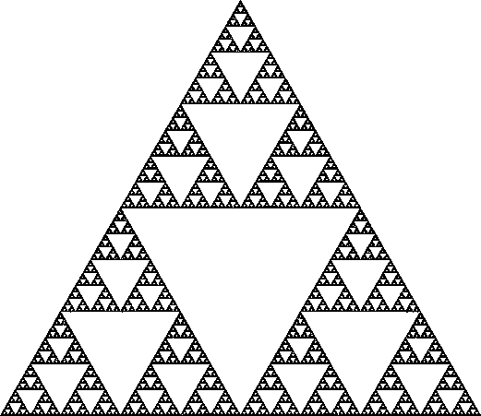
Sierpinski gasket

Slide 26
Measuring length and dimension:
the stick method

Slide 27
r

Slide 28
4

Slide 29
6

Slide 30
r
2π/2n
n
r sin (π/n)

Slide 31
Log (total length)
Log (length of side)
Notes:
Coastline length vs. Stick length

Slide 32
Measuring dimension – stick method
3

Slide 33
Measuring dimension – stick method
7/2
=3.5

Slide 34
Measuring dimension – stick method
16/4
=4

Slide 35
Measuring dimension – stick method
35/8
=4.38

Slide 36
Fractal dimension D = 1 - gradient
Log (total length)
Intercept gives
an idea of size
Log (length of stick)
Notes:
Trunk diameter – means something different for different sizes of organisms

Slide 37
The dimension of various coastlines
D = 1.18 for this example
D = 1.25 for the west coast of Britain,
D = 1.15 for the land frontier of Germany,
D = 1.14 for the land frontier of Portugal,
D = 1.13 for the Australian coast, and
D = 1.02 for the South African coast,

Slide 38
The stick method formalized
Total length (stick length)
Dimension
Constant
Stick length
intercept
gradient

Slide 39
Fractal dimension D = 1 - gradient
Log (total length)
Intercept gives
an idea of size
Log (length of stick)
Notes:
Trunk diameter – means something different for different sizes of organisms

Slide 40
Non fractal behavior
Fractal behavior
Non fractal behavior
Log (total length)
Log (length of stick)
Halley et al.
Notes:
Or different fractal dimensions at different scales

Slide 41
Non fractal behavior
Fractal behavior A
Fractal behavior B
Log (total length)
Log (length of stick)
Notes:
Or different fractal dimensions at different scales
Talk about a ball on a string

Slide 42
Koch Curve
1
Stick size
1
1/3
Length
1
4 × 1/3
Notes:
Miquel.com
Simplygreen.co.za
http://www.ibercivis.net/index.php?module=public&section=channels&action=view&id_channel=3&id_subchannel=133
http://therealsasha.files.wordpress.com/2011/10/snowflake-fractal.jpg
http://mthwww.uwc.edu/wwwmahes/mahes/index_000.htm
http://classes.yale.edu/fractals/panorama/Biology/Physiology/Physiology.html

Slide 43
Koch Curve
1
Stick size
1
1/3
1/9
Length
1
4 × 1/3
16 × 1/9
Notes:
Miquel.com
Simplygreen.co.za
http://www.ibercivis.net/index.php?module=public&section=channels&action=view&id_channel=3&id_subchannel=133
http://therealsasha.files.wordpress.com/2011/10/snowflake-fractal.jpg
http://mthwww.uwc.edu/wwwmahes/mahes/index_000.htm
http://classes.yale.edu/fractals/panorama/Biology/Physiology/Physiology.html

Slide 44
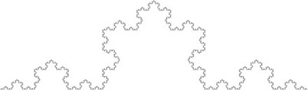
Koch Curve
1
Stick size
1
1/3
1/9
1/27
3^{-n}
Length
1
4 × 1/3
16 × 1/9
64 × 1/27
4^{n} × 3^{-n}
Notes:
Miquel.com
Simplygreen.co.za
http://www.ibercivis.net/index.php?module=public&section=channels&action=view&id_channel=3&id_subchannel=133
http://therealsasha.files.wordpress.com/2011/10/snowflake-fractal.jpg
http://mthwww.uwc.edu/wwwmahes/mahes/index_000.htm
http://classes.yale.edu/fractals/panorama/Biology/Physiology/Physiology.html

Slide 45
Koch Curve
3
Stick size
3
1
1/3
1/9
3^{(1-n)}
Length
3
4 × 1
16 × 1/3
64 × 1/9
4^{n} × 3^{(1-n)}
Notes:
Miquel.com
Simplygreen.co.za
http://www.ibercivis.net/index.php?module=public&section=channels&action=view&id_channel=3&id_subchannel=133
http://therealsasha.files.wordpress.com/2011/10/snowflake-fractal.jpg
http://mthwww.uwc.edu/wwwmahes/mahes/index_000.htm
http://classes.yale.edu/fractals/panorama/Biology/Physiology/Physiology.html

Slide 47
Box counting algorithm
Box length 1/2
Number boxes 20

Slide 48
Box counting algorithm
Box length 1/8
Number boxes 67

Slide 49
Box counting algorithm
Fractal dimension D = -1 × gradient
Log (N)
N = number of squares needed to cover the object
Intercept gives
an idea of size
Log (length of square)

Slide 50
In our example
Fern D = 1.767

Slide 51
Box counting algorithm
Fractal dimension D = -1 × gradient
Log (N)
N = number of hypercubes needed to cover the object
Intercept gives
an idea of size
Log (length of hypercube)

Slide 52
The box counting algorithm formalized
number of hypercubes needed to cover the object
Dimension
Constant
Hypercube length
intercept
gradient

Slide 53
Comparing box and stick methods
number of sticks needed to go round the perimeter
Dimension
Constant
Stick length

Slide 54
Comparing box and stick methods
number of sticks needed to go round the perimeter
Dimension
Constant
Stick length
Total length
Dimension
Constant
Stick length

Slide 55
Hausdorff dimension
The hausdorff dimension d of an object has the property that the number of balls of radius r needed to cover the object grows proportionally to r^{-d} as r becomes small
(Alexis Monnerot-Dumaine)
Notes:
Alexis Monnerot-Dumaine

Slide 56
Hausdorff dimension
Balls of radius r_{i} > 0 can cover the object
(Alexis Monnerot-Dumaine)
Notes:
Alexis Monnerot-Dumaine

Slide 57
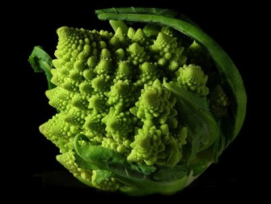
Why do fractals appear in nature?
In organisms
A simple set of rules (DNA)
Fractal structures are heritable
Need to maximize surface area but minimize volume
Efficiency of transportation
(Bailey et al. 2004)
Notes:
Kidney, circulatory system, lungs, brain
If something is made it is much harder to be fractal – though at some scale it will be because of mistakes and errors
Fractals have to grow or appear as a result of properties that are the same at multiple scales

Slide 58
Why do fractals appear in nature?
In geography
Same processes at multiple scales
In landscape ecology
In animal behavior
Chaos
Wait for the next lecture
Notes:
Kidney, circulatory system, lungs, brain
If something is made made is much harder to be fractal – though at some scale it will be because of mistakes and errors
Fractals have to grow or appear as a result of properties that are the same at multiple scales

